Slide 1
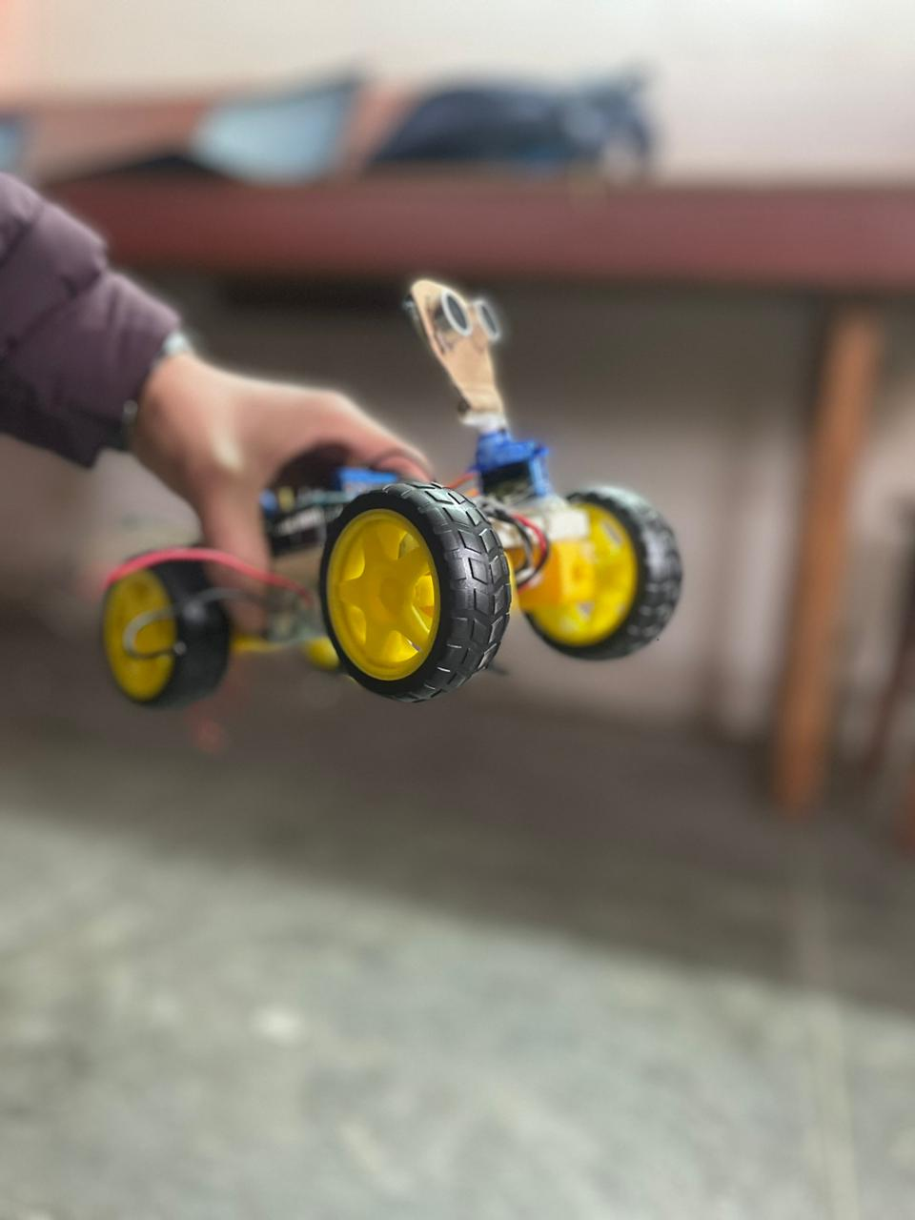
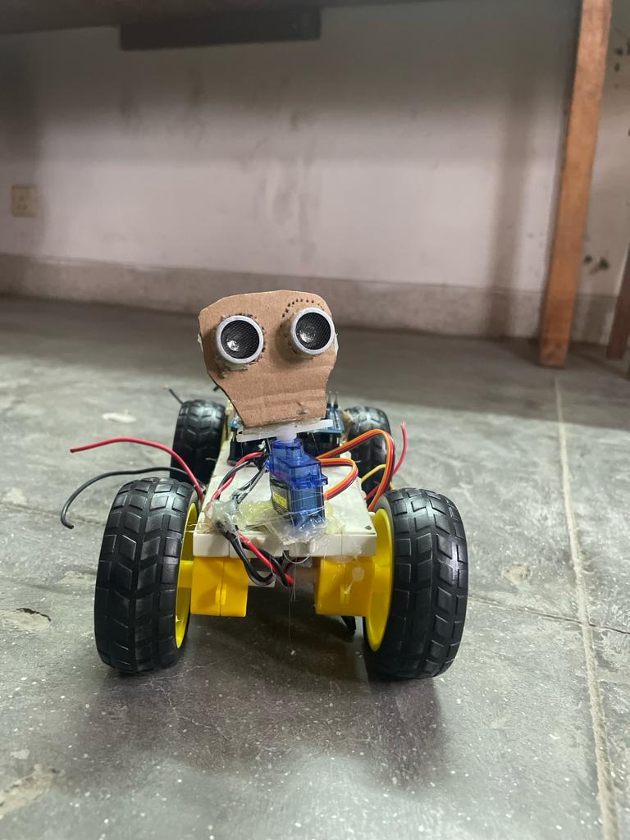
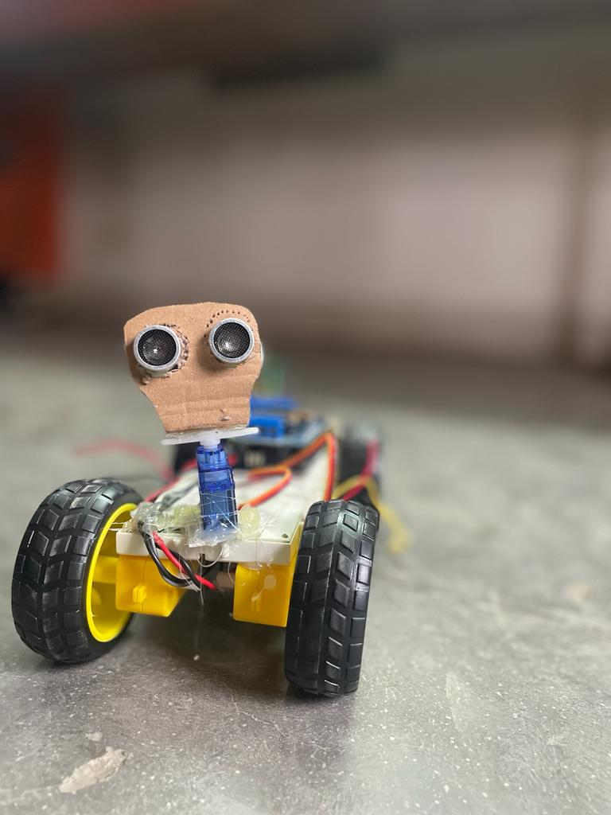
Obstacles Avoiding Smart Car

Slide 2
Sujan Thapa
Santosh Adhikari
Team Members
Raman Chaudhary
Bikesh Khyaju
Project Supervisor:
Suman Dhital
Sajesh Shrestha
Ritesh Chaudhary

Slide 3
Contents
Introduction
Problem Statement
Objectives
Use of Sensors
Working Mechanism
Further Works
Conclusion

Slide 4
Introduction
Smart car, which can automatically sense & overcome the obstacles.
Impressive fusion of robotics & technological innovation.
Heart of our project is Arduino.

Slide 5
Problem Statement
Need for the detection of obstacles that appear suddenly.
Need to minimize human risk in risky works.
Need to use and mobilize IOT.

Slide 6
Objectives
To build car that detects obstacles that appears in the way.
To minimize the human risks in the unknown environments.
To use and mobilize Iot Systems.

Slide 7
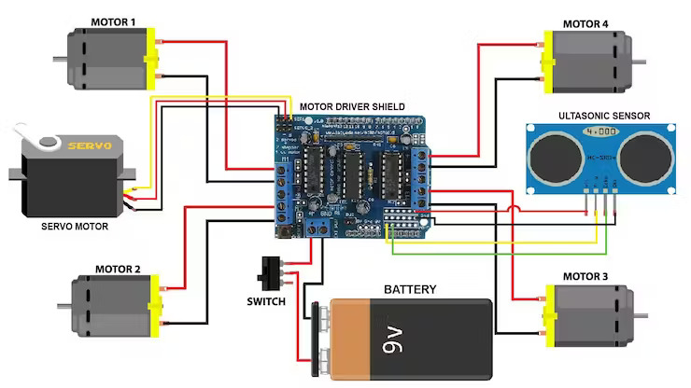
Circuit Diagram

Slide 8
Use of Sensors
Ultrasonic Sensor is used in our project.
Detects obstacles and measures their distance from the car.
Sends electrical signal to the Arduino.

Slide 9
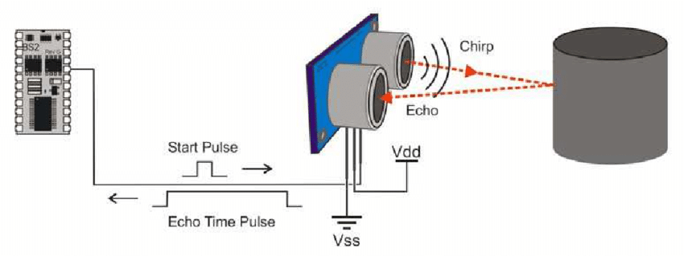
Working of Ultrasonic Sensor

Slide 10
Working Mechanism
Switched on by giving power.
Ultrasonic Sensor keeps sensing continuously.
Servo motor changes the direction of ultrasonic sensor.
Sends electrical signal to the Arduino.
Motor starts moving.
Obstacle detect then stop and move in another direction.
Process Continues…

Slide 11
Working Mechanism
6
6
3
5
4
1
6
2
6

Slide 12
Further Works
Alarms alert for obstacle detected can be developed.
Device with remotely controlled functionality can be developed.
Cameras can be added to give live visuals.

Slide 13
Conclusion
Our Iot project automatically detects obstacles.
Reduce risks for the humans in unpredictable environments.
project can be expanded further with new technologies in the future for better experience

Slide 14
Demo

Slide 15
Thank You

Slide 16
Any Questions…

